Slide 1


CORE PERIPHERY MODEL
Dr. Tanmoy Dhibor
Assistant Professor
Department of Geography
Hooghly Women’s College

Slide 2
CORE PERIPHERY MODEL
By Albert O. Hirschman

Slide 3
INTRODUCTION
Core periphery the concept of a developed core surrounded by an undeveloped periphery. The concept can be applied at various scales.
The core periphery model shows spatially how economic , political and cultural authority is dispersed in core or dominant regions and the surroundings peripheral and semi peripheral regions.
German economist Albert Otto Hirschman (1915-2012) discussed the concept of Core –periphery in his ‘Theory of Unbalanced Growth’.
Notes:
German economist Albert Otto Hirschman (1915-2012) discussed the concept of Core –periphery in his ‘Theory of Unbalanced Growth’.

Slide 4
What do you mean by Core?
The core is a central region in an economy ,with good communications and high population density , which conduce to its prosperity. The Core is contrasted with the periphery –outlying regions with poor communications and sparse population ( for example see unemployment)

Slide 5
What do you mean by Periphery?
Peripheria is an old Greek word that is used to describe the outside . In geographical terms we usually speak about the periphery in contexts of cities and regions . The periphery is usually the lesser developed part of a town or region, that is usually located at the edge of the cities or regions and far away from the developed ,more sophisticated and often beautiful city/regional centre.

Slide 6
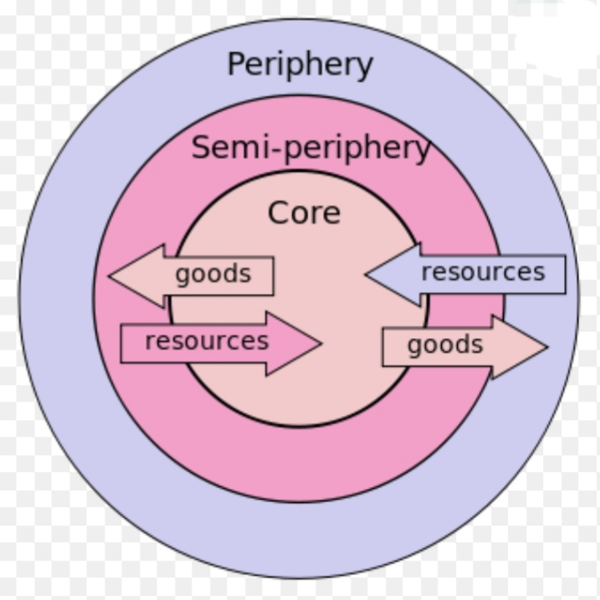
CORE PERIPHERY MODEL

Slide 7
CHARACTERISTICS OF CORE AND PERIPHERY
CORE
Developed area
Wealthy
More employment opportunities
Powerful
Control media & finance
Technologically advanced
Well transportation and communication services
PERIPHERY
Less developed
Poor
Less job opportunities
Dependent on core area for:
Education
Media
Military equipment
financing

Slide 8
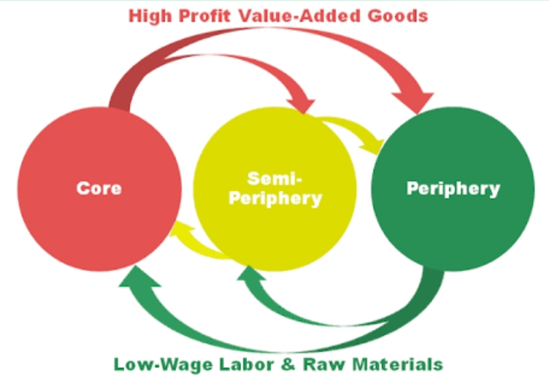
TRANSACTION BETWEEN CORE AND PERIPHERY

Slide 9
Spread Effects or Trickle Effects
Positive effects of the core’s growth on the periphery . Core unable to supply all the products the core is demanding so supply from the periphery to the Core. Core becomes affected by NEGATIVE EXTERNALITIES (high rents, overcrowding, congestion) so firms located in periphery.
Notes:
Positive effects of the core’s growth on the periphery . Core unable to supply all the products the core is demanding so supply from the periphery to the Core. Core becomes affected by NEGATIVE EXTERNALITIES (high rents, overcrowding, congestion) so firms located in periphery.

Slide 10
Backwash Effects or Polarization Effects
Negative effects of the core’s growth on the periphery. Out-migration of economically active people, outflows of capital , decreasing tax base , firms of the periphery not able to complete with the firms of the core and therefore periphery being flooded with core’s products.

Slide 11
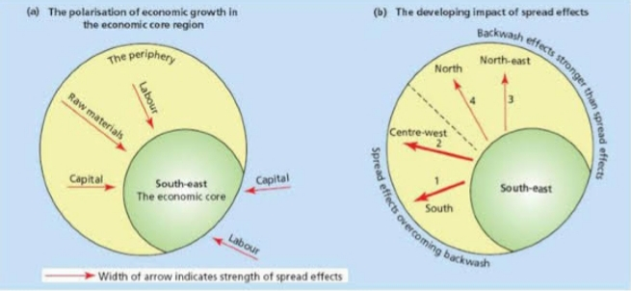
POLARISATION EFFECT AND SPREAD EFFECT

